Slide 1





LTD «PEREFERIO»
Despite the difficulties in the implementation of the Customer's project ideas, we embody the idea into reality

Slide 2
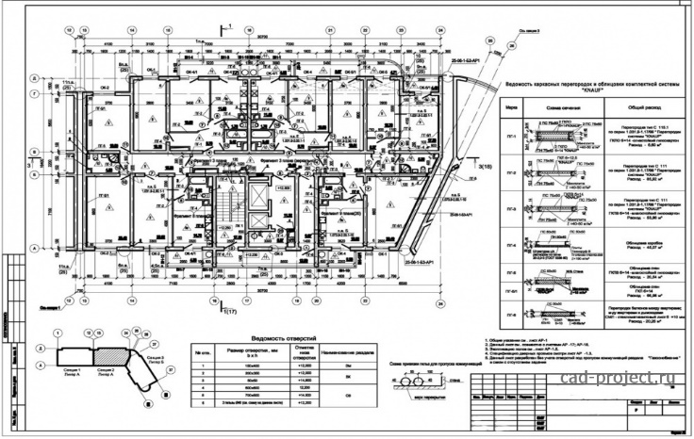
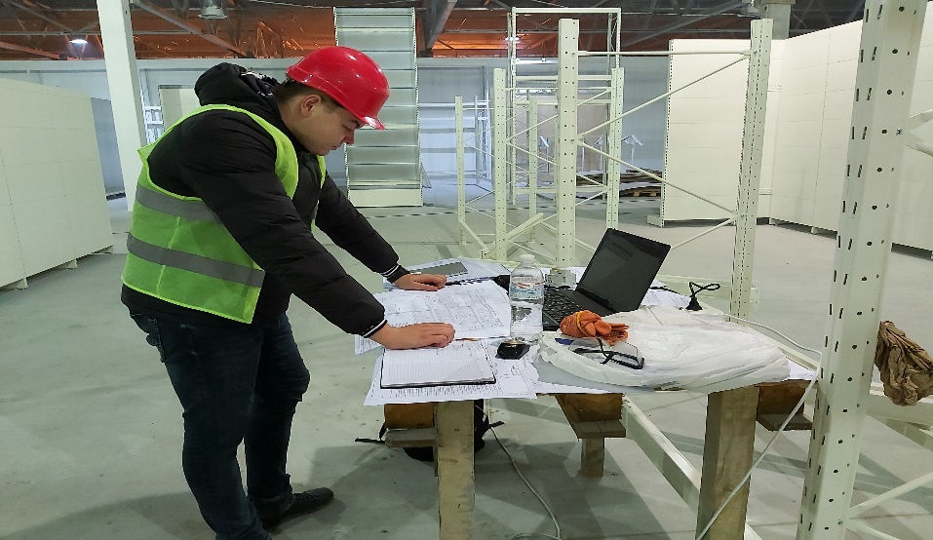
Our main engineering services:
Design documentation and estimate documentation;
Conceptual design, multimedia, and project documentation of stage P;
Management of construction works on the all cycles of work execution;
Supervision of construction activity by certified engineers;
Author's supervision;
Obtaining optimal technical conditions

Slide 3
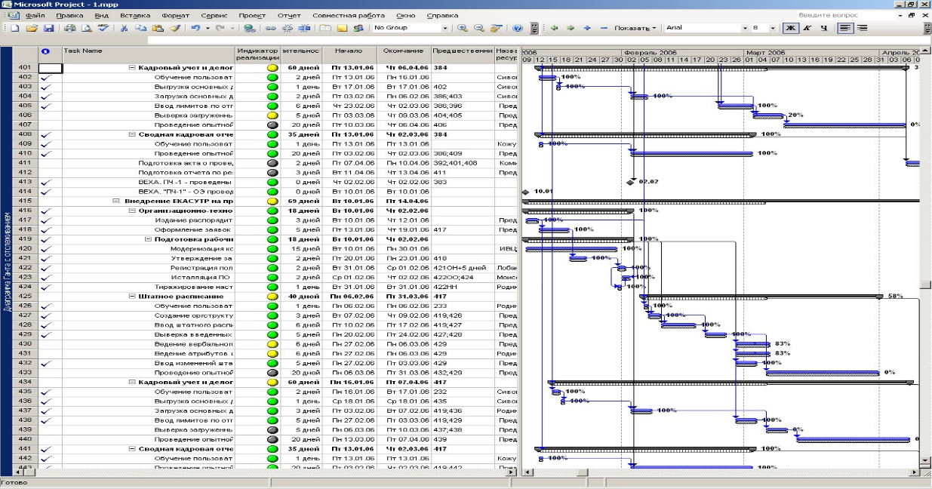
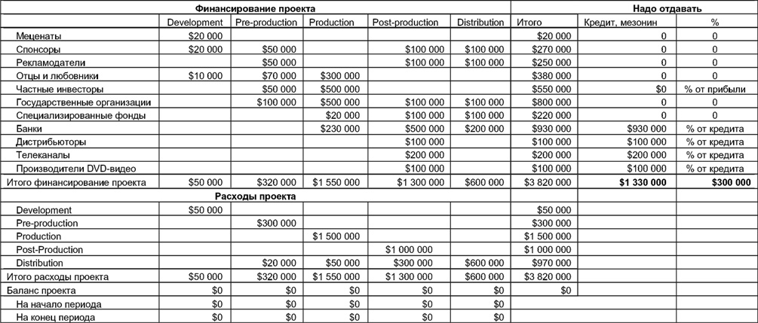
Budgeting and scheduling
Approval of project documentation in state control and supervision bodies;
Expert conclusions on design decisions;
Budgeting of projects at different stages of development;
Tender processing with strong regulation and supervision;

Slide 4
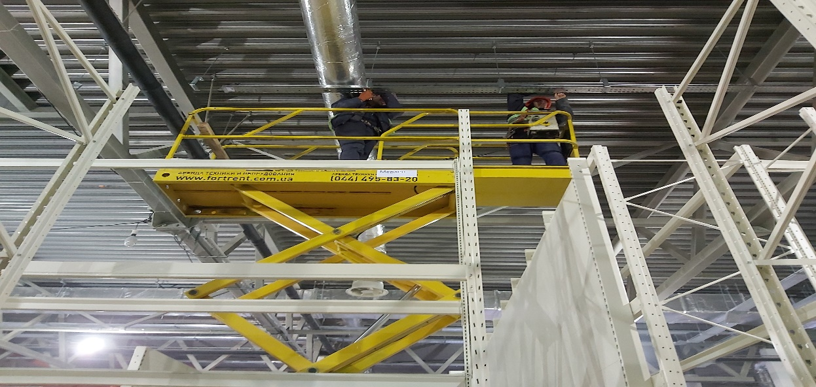
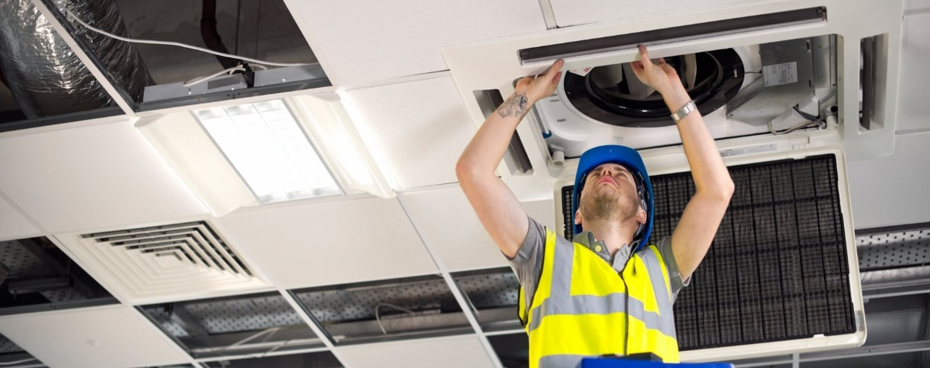
Technical modernization of buildings
Re-equipment and re-planning buildings
Replacement of the roof of buildings and structures
Technical re-equipment of heating and ventilation systems
Demolition and dismantling of buildings and structures

Slide 5

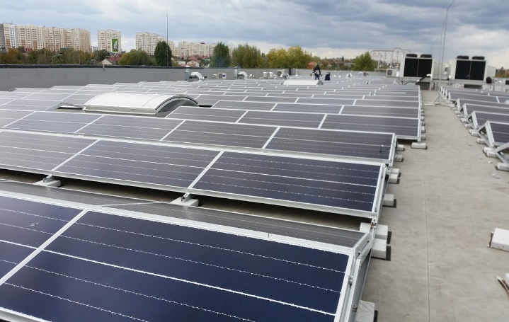
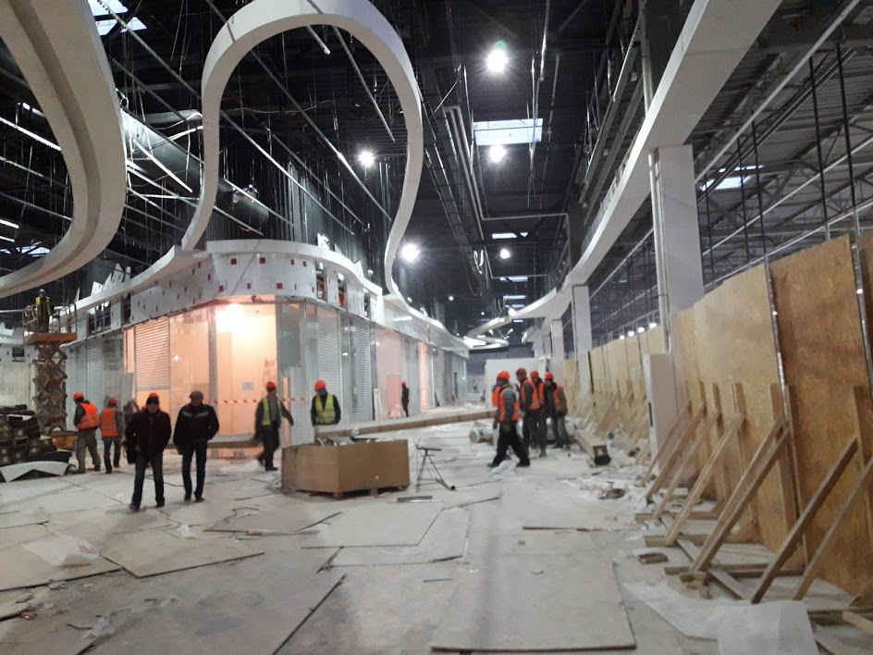
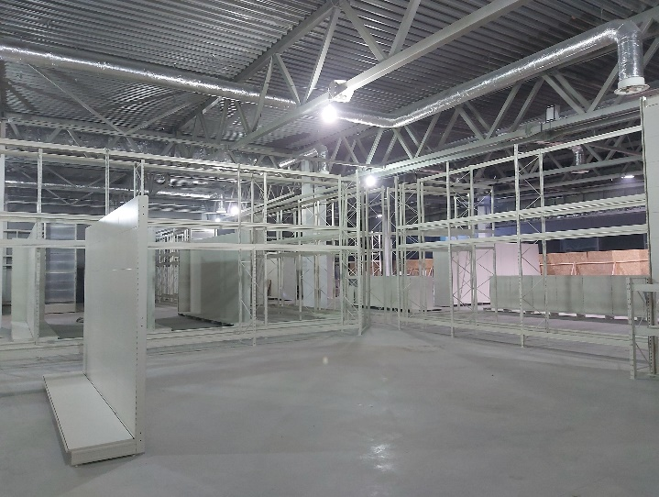
Finishing and furnishing works
Decorating and furnishing of premises;
Landscaping;
Installation of unhindered access to objects for disabled people
Furnishing of trading and office areas
Installation of solar systems

Slide 6
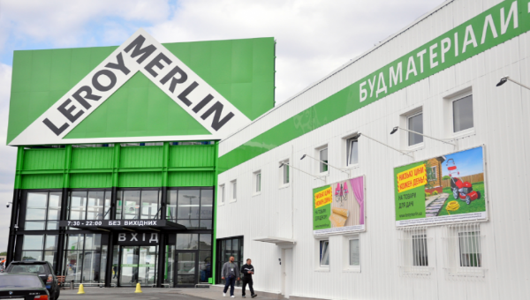
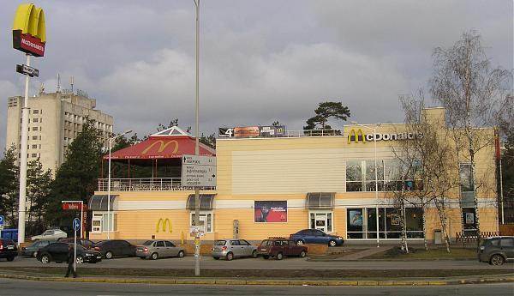
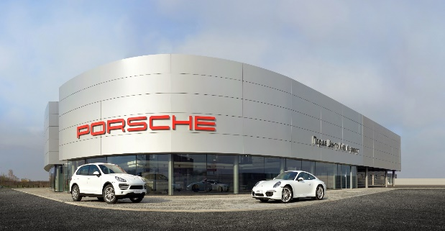
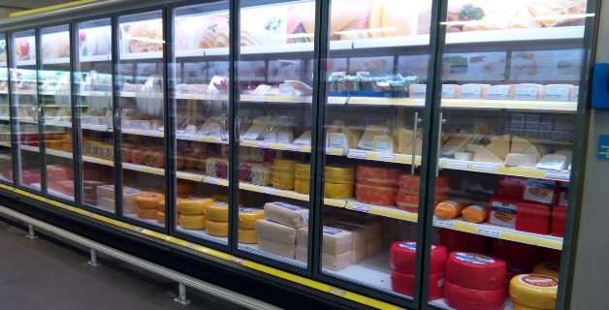
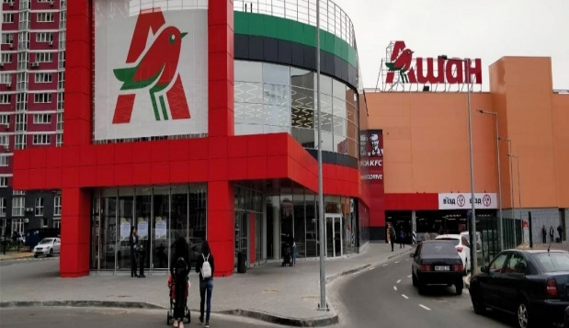
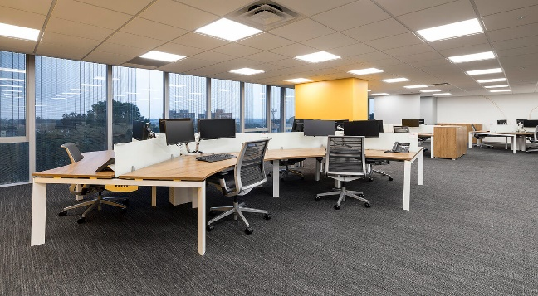
Participation of our staff in principal projects in Ukraine
Hypermarkets “Leroy Merlin” in Kyiv, and Odessa;
Construction and reconstruction chain restaurants “McDonald’s” in Ukraine 2003-2006years;
Construction “Porsche Center” on Boryspol highway
Reconstruction of Metro cash and carry in Kyiv (energy saving project);
New supermarket Auschan in Kyiv
Reconstruction office Johnson & Johnson

Slide 7
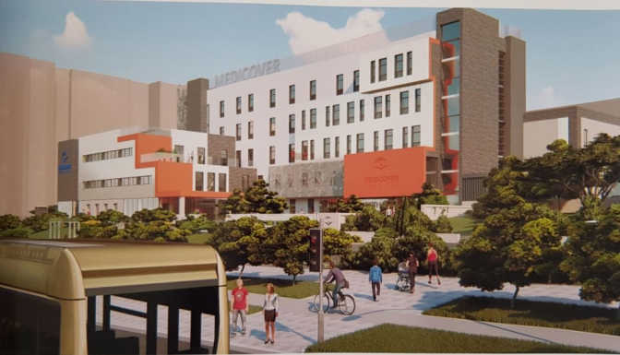
Participation of our staff in process of approval and purchasing service for different projects in Ukraine
“Medicover”– medical center and maternity house in Lviv;
“Leroy Merlin” in Kyiv;
“Ukrainian Retail” in Dnipro
“Tetra Laval” in Kyiv
“Phillip Morris” in Kharkov
“Amstar Europe” in Kyiv
Our Permit service has saved hundreds of thousands of dollars for our customers, and open property in time;
Our main aim to receive permit for construction activity, ecological permission and receive property certificate;
Our purchasing service allowed to our clients economy huge amount of money. Our company have a special discounts with principal suppliers and producers of Ukraine;

Slide 8

We are ready to new cooperation!
Ukraine, Kyiv, 03151, Molodogvardeyskaya street, 22 tel. +38 044 288 40 90, mob. +38 050 3116634, e-mail: asalov@Pereferio.com web: www.pereferio.com

